Slide 1
Category review: Chips
September 2023
Retail Analytics
Brand note: If client logo is not required, use alternate title page layout right click slide thumbnail > Layout > Title

Slide 2
Notes:
To view Privacy video explaining how important data privacy is to Quantium, please click here: https://www.youtube.com/watch?v=Zq1QDAkoRzU
or here Q:\Company Reference\Brand & Design\Brand videos\Q Privacy.mp4
At Quantium, we believe that data is the behavioural footprint of humanity and that it has to be treated with the utmost care and responsibility.
Histories, attitudes, indeed lives are stored within it in ways that aren’t always apparent – and that’s what makes its potential so powerful.
To work with it responsibly, sensitively, we set ourselves the highest data privacy protection and governance standards.
We have spent 17 years perfecting privacy-by-design and secure-by-design principles. Central to this is not holding any personally identifiable information about people –
we neither receive it, and put the necessary protections in place to be unable to decipher it.
Every aspect of handling data is safeguarded: from its de-identification, to its encryption – data security is paramount and of the highest grade.
We pride ourselves on gaining the trust of iconic organisations around the world through years of securely working with their data,
and in turn the trust that builds with their stakeholders.

Slide 3
Executive summary
01
Task 1
Here you will include your high-level findings and any key callouts for task 1
02
Task 2
Here you will include your high-level findings and any key callouts for task 2

Slide 4
01
Category

Slide 5
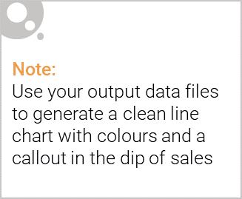
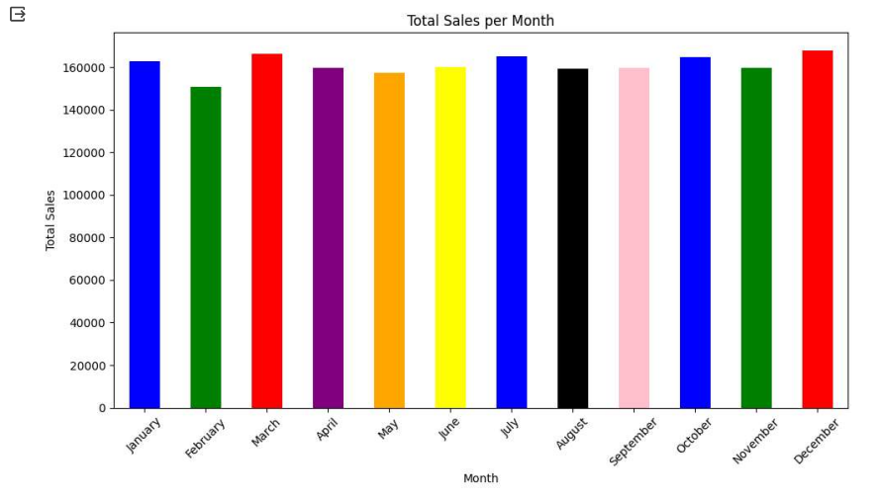
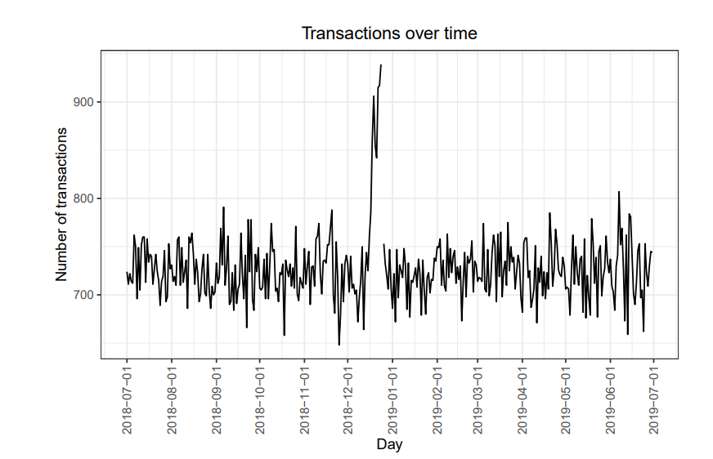
In this task an overall analysis was revealing the customers types and their sales preferences
As months analysis can’t reveale much , the number of transaction by day can say a lot about how every start of the year and with less intensity start of months the sales increase .
The customer sales cannot be judged based on the period when almodt all sales per month are close values

Slide 6
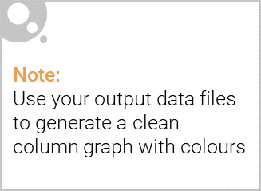
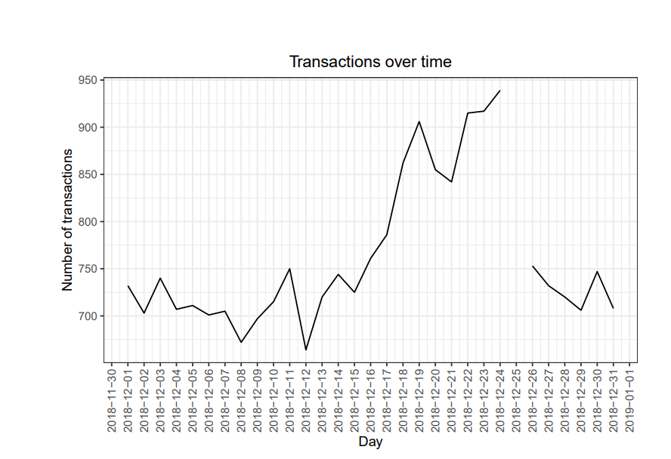
This affluence and its effect on consumer buying for the category of chips
As cocnlusion and after zoom in on the second graph, we can conclude that the christams preparation days are the busiest days for the stores
It's evident that sales surge in the days leading up to Christmas, while there are no sales on Christmas day itself, primarily because stores are closed on that day.

Slide 7
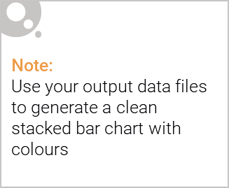
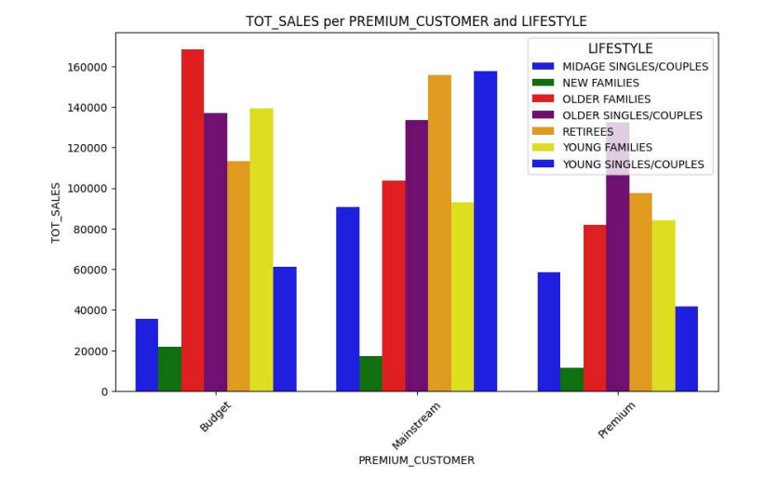
Editable (delete this)
Stretch: Try visualising the proportion of customers by affluence and life stage on this slide
*for the mainstream customers : midaged singles and couples and retreties are the number one target
*for the Budget customers:
older families are the number one buyers for this category
*for the premium customers : older singles and couples are the ones making the highest sales for this category

Slide 8
02
Trial store performance

Slide 9
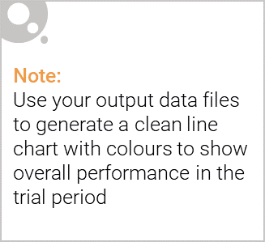
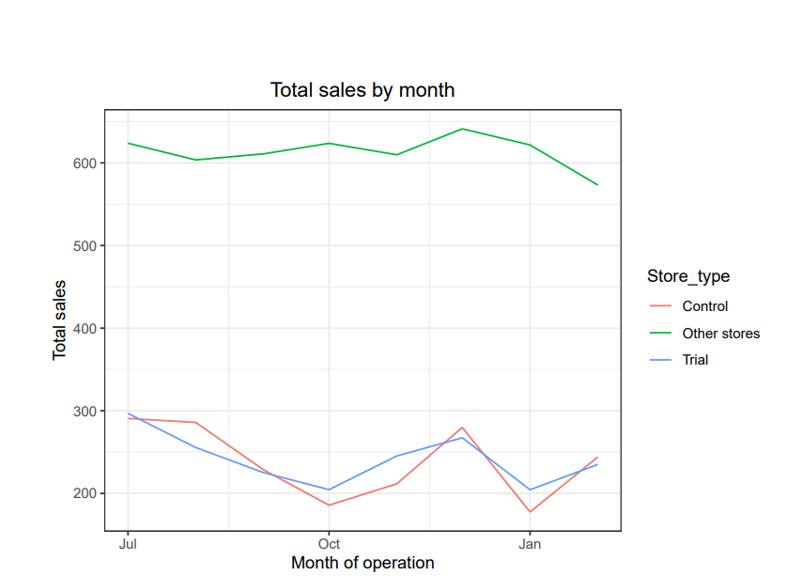
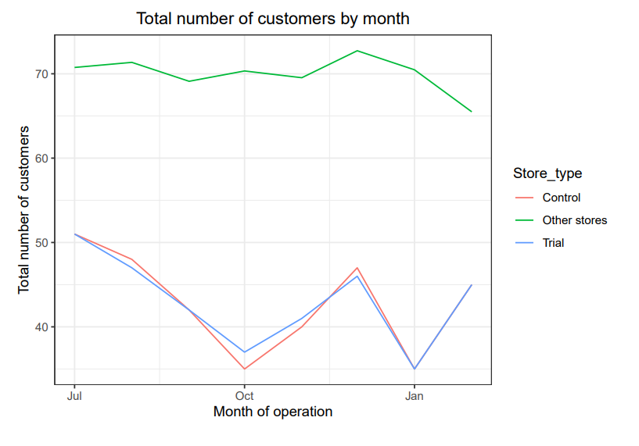
Explanation of the control store vs other stores
At first glance the contrôle stores present lower sales number and thus lower customer numbers than the other stores .
With further anlaysis we concluded that Store 77's trial period differs significantly from its control store in two of three months. Store 155 is a potential control for store 86, with visual pre-trial checks needed. Store 86's trial aligns with its control, except for two months, with increased customer numbers. Store 237 could be a control for store 88, needing visual pre-trial checks. Store 88's trial significantly differs in two months, particularly with more customers, implying a positive trial impact.

Slide 10
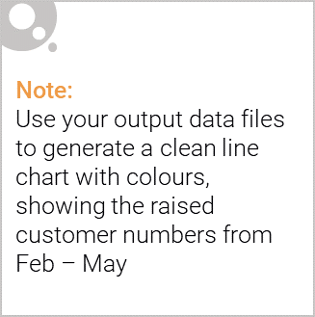
Control stores have been identified: 233, 155, and 237 for trial stores 77, 86, and 88, respectively. Trial stores 77 and 88 exhibit significant differences in at least two of the three trial months, while trial store 86 does not. It's worth discussing with the client if trial implementation varied in store 86. Nonetheless, the trial indicates a substantial sales increase..

